Slide 1
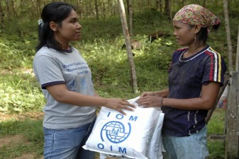
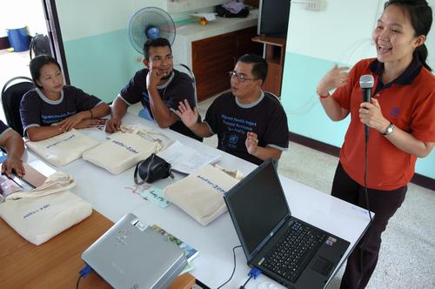
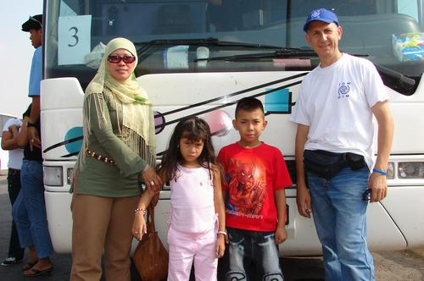
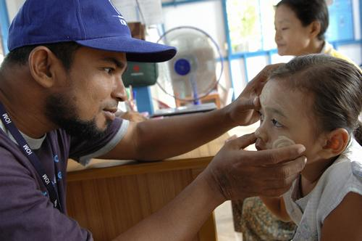
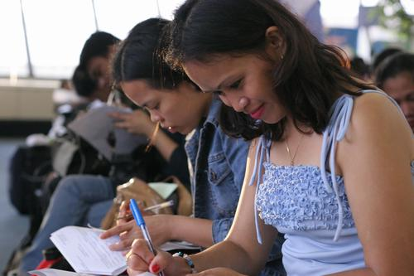
Civil Society Exchange & Networking Seminar on Trafficking in Human Beings
The International Organization for Migration (IOM)
Irina Todorova
October 2013

Slide 2
IOM’s approach towards THB
IOM takes a comprehensive approach to trafficking in human beings within the context of assisting migrants in need – a corner stone of IOM’s work.
The approach is based on three principles that govern all counter- trafficking activities:
1. Respect for human rights
2. Physical, mental and social well-being of the individual
and his or her community
3. Sustainability through institutional capacity building of
governments and civil society
IOM sets operational standards to achieve sustainable results that will:
Provide protection and empower trafficked women, men, girls and boys;
Raise awareness and understanding of the issue;
Bring justice to trafficked persons.

Slide 3
Ensuring Proper Protection for All Victims of Human Trafficking
(Global Perspective)
Context
Challenges
3. Best practices
4. Recommendations
3

Slide 4
CONTEXT
Home
(country of origin)
Abroad
(country of destination)
Prevention
Causes of Trafficking → Forced Migration?
Few job opportunities for women
Limited legal alternatives to work abroad
Growth of women as sole supports of families
Gender and youth issues
Lack of social safety nets
Domestic violence
Prostitution
Substance abuse
Unequal access to opportunities
due to corruption
→ Re-integration into
the same socio-economic
environment?
Circumstances of Trafficking
Exploited & Trapped
Circumstances of Return
Cure
Areas covered by counter-trafficking activities
4

Slide 5
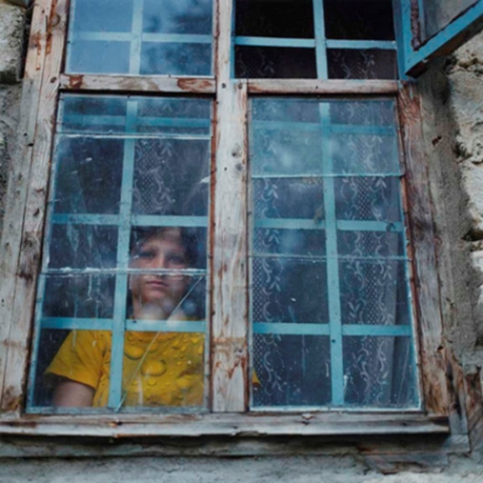
CONTEXT
Different contexts | Countries of destination | Countries of origin
Prosecution | Law enforcement: exploitation | Law enforcement: recruitment
Protection | Short-term pre-departure assistance/ rehabilitation and reintegration | Long term rehabilitation and reintegration
Prevention | Demand side | Pro-active prevention – root causes
5

Slide 6
CONTEXT
Different Partnerships in the Fight against Trafficking
 | Aim/Purpose | Challenges | Assessment
Government | “Sustainability” Prosecution monopoly Social protection/Good Governance | Incentives Prosecution monopoly Prejudices | We are better but far from where we have to be
Agencies, NGOs, Civil Society | Avoid duplication Coordination Advocacy Information sharing | Competition Jealousy Branding Run for the buck | Mixed picture
Donors | Advocacy Informed decisions | Disinformation Decision taken in capitals Trend and fashion driven | Mixed picture
Beneficiaries | Rebuild life From object to subject of their destiny Involve in advocacy | Return to broken home Stigma, including from care-givers Distant from decision makers | This hasn’t really started yet
6

Slide 7
CHALLENGES: Changing Trends
CT Practitioners are not keeping up with changing trends
Low level of Identification (including self-identification)
New forms of exploitation
New victims of trafficking (VoT) profile
New routes

Slide 8
CHALLENGES: Services to VoTs
Identification and status determination
Reflection period and temporary residence permit
Conditional access to assistance
Rehabilitation linked to criminal proceedings (what happens after ?)
Return as the preferred option by most states
Lack of understanding of the root causes by CoD
Difficulties of reintegration in the same environment which may have caused trafficking
Inadequate pre-departure risk and family assessment

Slide 9
CHALLENGES: Cooperation
Lack of Understanding and Cooperation between Countries of Destination and Countries of Origin related to Protection and Assistance:
Cooperation limited only to law enforcement and investigation domains
Legal assistance, including representation in CoD and in Country of Origin
Access to Compensation
Information about the status and results of penal procedures in cases of cooperation with police

Slide 10
BEST PRACTICES: Implementation of NRM
OSCE Plan of actions regarding combating THB, approved at the Maastricht Meeting of the Council of Ministers, 2003;
OSCE/ODIHR practical handbook – NRMs. Joining Efforts to Protect the Rights of Trafficked Persons, 2004;
European Union Plan regarding Best Practices, Standards and Procedures for Combating and Prevention of THB, p. 2 (с), 2006;
2012 – 2016 EU Anti-Trafficking strategy – June 2012.

Slide 11
NRM – mechanism to protect human rights
NRM - cooperative frameworks through which states actors fulfill their obligations to protect and promote the human rights of trafficked persons, coordinating their efforts in strategic partnership with civil society.
The main aspects of NRM – partnership & coordination that provide for:
Access of VoTs to assistance and protection – by improving the system of identification of the VoTs and development of the local network of assistance based on common procedures;
Improving the prosecution of traffickers – by harmonization of the interests of the VoTs and the interest of prosecution;
c) Strengthening prevention of THB – by providing social assistance for potential victims;

Slide 12
Prevention of THB through assistance to Potential Victims
Target group:
Country of Origin:
VoT’s family members, specifically children;
Vulnerable persons with a profile similar to victims prior to trafficking -
victims of domestic violence, abuse, neglect and abandonment;
Children and elderly left behind;
Country of Destination:
Migrants with mental and physical disabilities;
Unaccompanied Minors;
Stranded migrants;
Services provided
Case by case - individually tailored assistance program, including family level
12

Slide 13
NRM Best Practices
Integration of the NRM into the national system of protection and social assistance;
Referral of cases within NRM (partnership between Local Public Administration (LPA) and Civil Society);
Prevention of THB through social assistance to potential victims and/or at risk groups;
Development of transnational cooperation - inclusion of protection institutions.
13

Slide 14
Institutional Framework of NRM : Multidisciplinary Team (district/community based coordination)
Basic operational unit at the local level, ensuring intersectorial cooperation of local institutions for assistance and protection of Vots and potential victims
District Directorate
for Education,
Youth and Sports
Identification
Case analysis, incl. risk and family
Preparation of the rehabilitation and reintegration plan
Assessment of needs for development of specialized community based services
Monitoring of cases
…
District
Healthcare Facility
Social Assistance
Division,
Multidisciplinary
Team Manager
Civil Society
Police Station
Civil Registry Office
Territorial
Employment
Agency
14

Slide 15
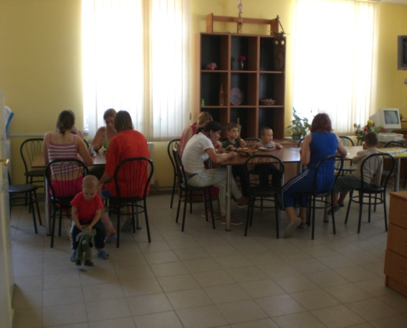
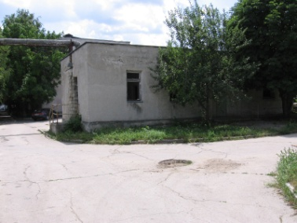
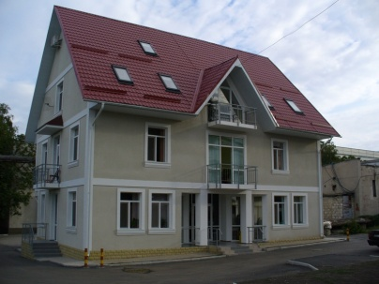
NGO Centre for Prevention of Trafficking in Women
Center for Combating Trafficking in Persons
(police task force)
General Prosecutor’s Office
Chisinau Assistance and Protection Centre
Temporary Residence Psychological Counseling
Social Support Medical Assistance
Legal Support Recreational Activities
Ministry of Social Protection, Family and Child
15

Slide 16
NRM: Efficiency
Political support to NRM at all levels- transnational, national, local;
NRM Coordinator defined by Law – Ministries dealing with social affairs, prevention of violence etc.;
Financial support from the state – multidisciplinary approach;
Monitoring of the implementation by national coordinator – ownership & accountability;
Development of informal relations between NRM participants at all levels of coordination;
Development of the normative basis for solving the problems of guarantee of human/victim’s rights ( identification, witnesses protection, compensations for caused damage, medical assurance etc.);
Consolidation of the professional capacities and individual stimulation.
16

Slide 17
General recommendations
To strive for full execution of commitments and obligations;
Development and implementation of NRM – the best victim centered coordinated assistance framework;
Better identification due to broader view on THB;
Adapting assistance programs according to the VoTs needs;
Risk assessment and family assessment - Informed decision;
Return should be an option and one of protection measures but not the only option (esp. when criminal proceedings are over and/or VoT doesn’t want to cooperate with Police);
Interstate cooperation should continuously be developed in accordance with the new trends and challenges that arise and expanded to Social Protection Authorities;
17

Slide 18
Concluding remarks
NRM – Partnership/Coordination between GO & Civil Society
Prevention is better than a cure!
Observation and analysis of the new trends of THB
NRM should be flexible in line with THB phenomenon
Bigger focus on the Demand side!
Prevention of Corruption and Impunity in the Fight Against THB through Empowering the Media and Fostering Cooperation between CS and LE
18

Slide 19
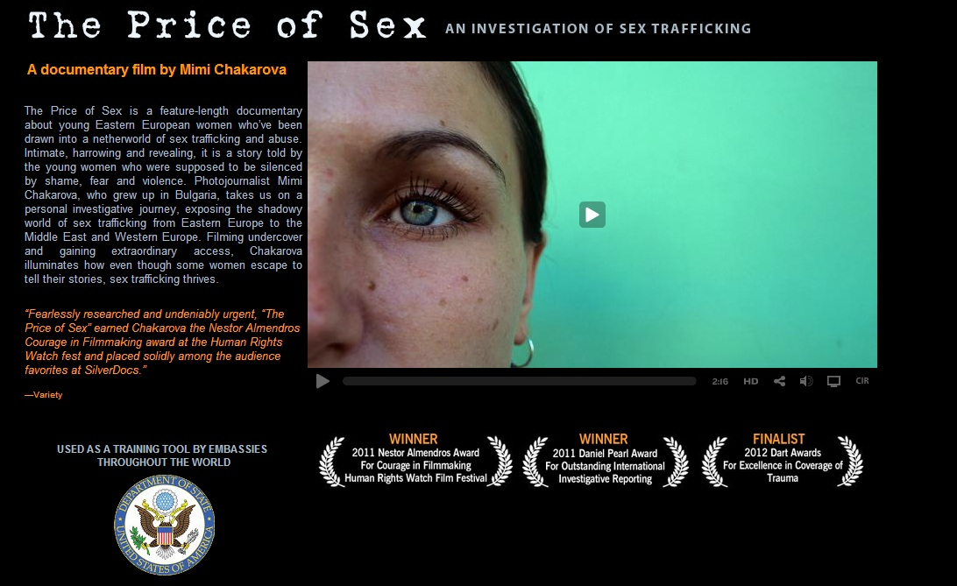

Slide 20
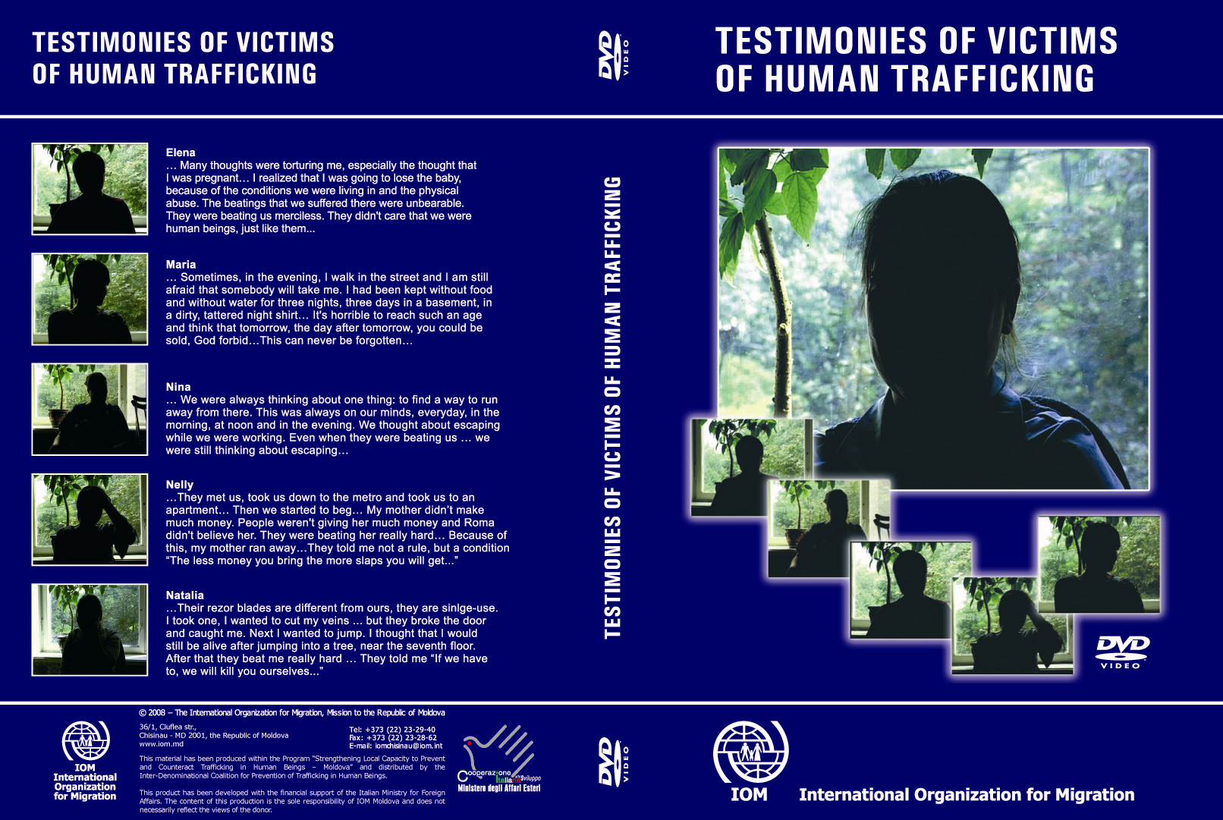
Participation of Victims

Slide 21
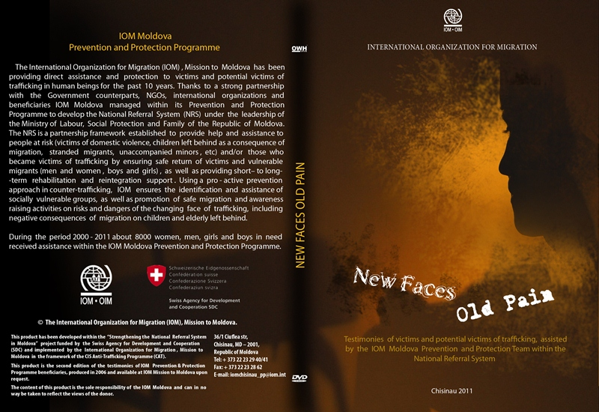
Participation of Victims

Slide 22
Thank you for your attention !
Irina TODOROVA
Counter-Trafficking Specialist
IOM - International Organization for Migration
E-Mail: itodorova@iom.int
22
22

